Slide 1
[Pepper Leaf disease classification Using Deep Learning Architecture] Course Name: Data Mining Lab Course Code: CSE-476 Intake – 41

Slide 2

Presented By –
Group No –
Name: Pallab Majumdar [18192103050]
Name: Al Ahad sufian [18192103056]
Name: Mafuja akter mitu [18192103068]
Name: sadeka jafrin [18192103069]
Name: Habibullah [18192103080]
Presented To –
Khan Md. Hasib
Assistant Professor
Department of CSE
Bangladesh University of Business and Technology (BUBT)
Email: khanmdhasib@bubt.edu.bd

Slide 3
INDEX
Introduction
Motivation
Objectives
Contributions
Related Work
Previous Work
Dataset
Challenges
Future O/P

Slide 4
Introduction
Motivation
Objectives
Contributions

Slide 5
Introduction
Pepper plants are an important crop worldwide, providing essential nutrients and adding flavor to many dishes. However, pepper plants are susceptible to various diseases caused by fungi, bacteria, and viruses, which can result in significant crop losses. Early detection and accurate identification of these diseases are crucial for identifying and categorizing different diseases affecting pepper plants based on their symptoms, such as leaf spots, discoloration, and wilting to minimize losses.
It can also reduce the reliance on manual inspection, which is time-consuming and can be prone to human error, and ensure food security.

Slide 6
Motivation
Ensuring food security, improving the livelihoods of farmers
Minimizing crop losses
Minimize the environmental impact for the production of healthy and high-quality crops.
Develop automated systems that can accurately classify leaf diseases from images of affected leaves

Slide 7
Objectives
Ensure that the models have a high level of accuracy in classifying different pepper diseases.
Develop models that can be scaled up to handle large volumes of data, allowing for efficient processing of images of affected pepper plants.
Develop models that promote sustainable agricultural practices by reducing the use of pesticides and other chemical treatments

Slide 8
Contributions
We proposed a leaf disease identification network, CNN, that classifies diseases affecting the plants.
We have conducted an extensive set of experiments to research the best suitable network using transfer learning.
We have carried out a detailed analysis of the performance of all the networks applied for disease detection in crops.

Slide 9
Related Work
Previous Work

Slide 10
Previous Work
Li et al. (2020), proposed a CNN-based model classifying pepper diseases that achieved an accuracy of 94.6% in classifying five different types of pepper diseases.
Dong et al. (2020), proposed a transfer learning-based pepper disease classification that achieved an accuracy of 96.0% in classifying three different types of pepper diseases.
”Deep learning-based disease diagnosis using leaf images of apple trees” by X. Liu et al. (2021) in which a CNN-based system was developed to identify apple scab, a common apple leaf disease. The study found an accuracy of 96.3%.

Slide 11
Previous Work
”Deep learning for plant disease detection” by Y. Peng et al. (2022) in which a CNN-based system was developed to identify 14 different plant diseases using leaf images. The study found that the CNN-based system achieved an accuracy of 95.2%.
”Plant disease detection using deep convolutional neural networks” by A. K. S. Kumar et al. (2019) in which a CNN-based system was developed to identify diseases in tomato and pepper plants. The study found that the CNN-based system achieved an accuracy of 98% and 97% respectively.
”Real-time plant disease detection using deep learning” by S. S. Teo et al. (2020) in which a CNN-based system was developed to identify diseases in soybean plants. The accuracy is 95.8%.

Slide 12
Previous Work
Monishanker Haldar et.al. presented a detailed survey on various leaf disease identification using Image processing techniques based on algorithms like K-means clustering, support vector machine, ANN, Fuzzy logic, etc. Based on their survey, using the Machine learning approach achieved the highest accuracy of 95%.
Sladojevic, S., et al. discussed an approach to deep classification for identifying herbal diseases based on image leaf classifications. The models developed for 13 types of plant diseases.This study achieved an accuracy of 96.5%.

Slide 13
Dataset

Slide 14
Dataset
The dataset contains a total of 10000 images, where each image is of size 256x256 pixels and is in JPG format.
The dataset is divided into 10 classes, where each class represents a different type of pepper disease. Each class has 1000 images.
By using Keras ImageDataGenerator class and flow_from_directory() API, we load our images.
The API selects the data to be divided into two different directories which are the train/ directory and test/ directory, and each directory has subdirectory for train/healthy pepper leaves and train/ bacterial pepper leaves, similarly for the test/ directory.

Slide 15
Dataset
We randomly select 25% of the images for testing the dataset.
We also use Data Augmentation technique to generate more synthetic dataset.
We split our whole dataset into 80% and 20% ratio for fitting in the model.

Slide 16
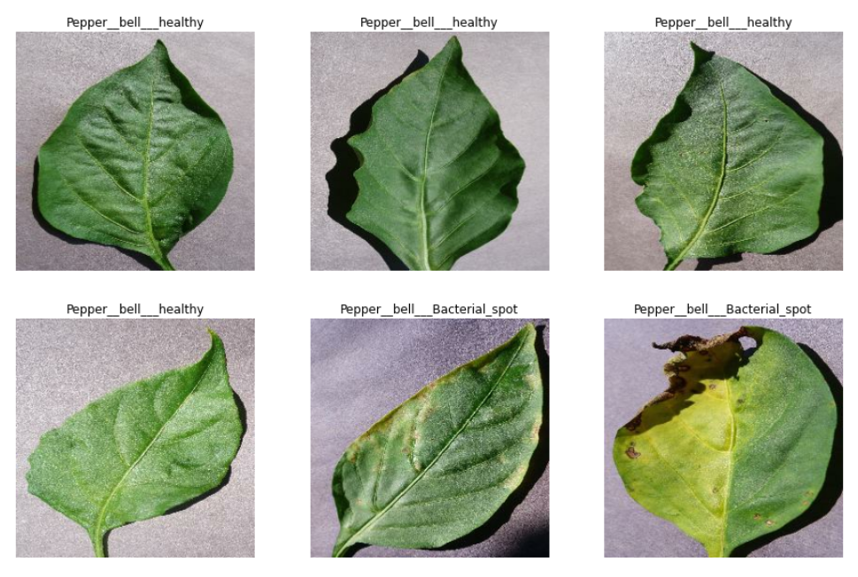
Dataset

Slide 17
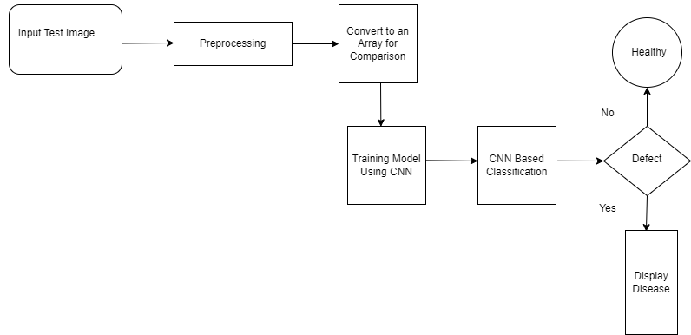
Flowchart

Slide 18
Challenges

Slide 19
Challenges
Environmental factors
Symptom variability
Limited resources
Lack of trained personnel
Disease transmission

Slide 20
Future O/P

Slide 21
Future O/P
Develop a mobile application that can be used by farmers to detect diseases in their pepper plants using the trained model.
Extend the model to identify diseases in other crops such as tomatoes, potatoes, and eggplants.
Integrate the model with IoT devices to monitor crop health in real-time and alert farmers of potential diseases.
Investigate the use of other deep learning architectures and techniques such as ensemble learning and attention mechanisms to improve the accuracy of the model.
Collaborate with agricultural organizations and governments to deploy the model in real-world scenarios and provide support to farmers in need.

Slide 22
Thank You All

